Slide 1
Software Reliability
Module-7

Slide 2
Define SW reliability and analyze its role in SW Systems.
Two main types of reliability models:
  Time dependant
  Time independent
Develop Reliability Characteristics based on experimental data
Software Reliability and Software Design

Slide 3
Notion of Reliability
Aims at fault-free performance of software systems
Software reliability goes hand-in-hand with software verification
  Input: collection of software test results
  Goal: assess the validity of the software system
Targets safety-critical software

Slide 4
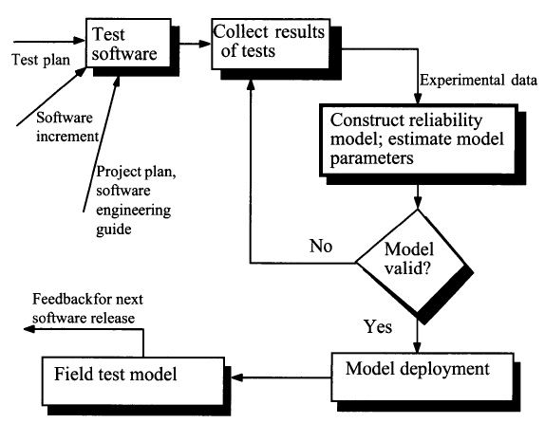
Reliability Assessment

Slide 5
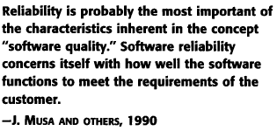
Role of Reliability in Software Engineering

Slide 6
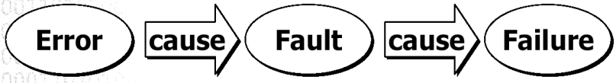
Error, Fault and Failure
Error: human action that results in software containing a fault
Fault: a cause for an internal error (failure)
Failure: any observable divergence of software behavior in execution from user needs
Failure intensity: the number of failures per time unit

Slide 7
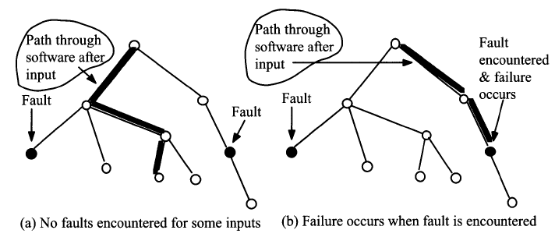
Error, Fault and Failure

Slide 8
More Basic Notions
Failure: any observable divergence of software behavior in execution from user needs
Failure intensity: the number of failures per natural or time unit. Failure intensity is a way of expressing reliability.
Availability: The probability that at a given time that a system or a capability of a system functions satisfactorily in a specified environment.
  If you are given an average downtime per failure, then availability implies a kind of reliability.

Slide 9
Classical Definition of Reliability
Software Reliability is the probability that a system will operate without failure under given environmental conditions for a specified period of time.
We express reliability on a scale from 0 to 1:
  highly reliable system will have a reliability measure close to 1, and
  unreliable system will have a measure close to 0.
Reliability is measured over execution time so that it more accurately reflects system usage.
GOAL: reliability must be quantified so that we can compare software systems

Slide 10
Time
“Time” is execution exposure that software receives through usage.
It is usually measured in central processing unit (CPU) execution-time, calendar-time or clock time.

Slide 11
Characters of Software Reliability
Failures are primarily due to design faults.
  Repairs are made by modifying the design to make it robust against conditions that can trigger a failure.
There is no wear-out phenomena.
  Software errors occur without warning.
  “Old” code can exhibit an increasing failure rate as a function of errors induced while making upgrades.
  External environment conditions do not affect software reliability.
  Internal environmental conditions, such as insufficient memory or inappropriate clock speeds do affect software reliability.
Reliability is not time dependent.
  Failures occur when the logic path that contains an error is executed.
  Reliability growth is observed as errors are detected and corrected.

Slide 12
Software v.s. Hardware Reliability
Software Reliability
Hardware Reliability
Failures are primarily due to design faults. Repairs are made by modifying the design to make it robust against conditions that can trigger a failure.
Failures are caused by deficiencies in design, production, and maintenance.
There is no wear-out phenomena. Software errors occur without warning. “Old” code can exhibit an increasing failure rate as a function of errors induced while making upgrades.
Failures are due to wear or other energy-related phenomena. Sometimes a warning is available before a failure occurs.
There is no equivalent to preventive maintenance for software.
Repairs can be made which would make the equipment more reliable through maintenance.
Reliability is not time dependent. Failures occur when the logic path that contains an error is executed. Reliability growth is observed as errors are detected and corrected.
Reliability is time related. Failure rates can be decreasing, constant, or increasing with respect to operating time.

Slide 13
Software v.s. Hardware Reliability
External environment conditions do not affect software reliability. Internal environmental conditions, such as insufficient memory or inappropriate clock speeds do affect software reliability.
Reliability is related to environmental conditions.
Reliability cannot be predicted form a knowledge of design, usage, and environmental stress factors.
Reliability can be predicted in theory from physical bases.
Reliability cannot be improved by redundancy, since this will simply replicate the same error. Reliability can be improved by diversity.
Reliability can usually be improved by redundancy
Failure rates of software components are not predictable.
Failure rates of components are somewhat predictable according to known patterns.
Software interfaces are conceptual.
Hardware interfaces are visual
Software design does not use standard components.
Hardware design uses standard components.

Slide 14
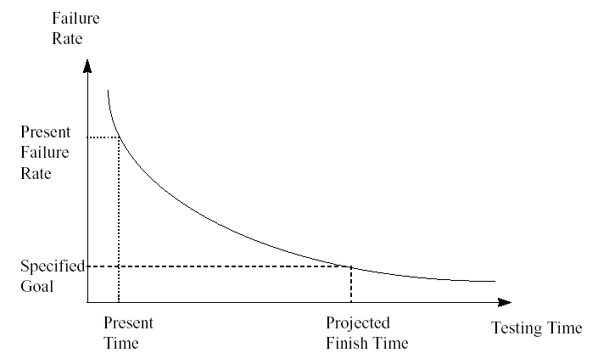
Software Reliability Modeling
A software reliability model specifies the general form of the dependence of the failure process on the principal factors that affect it:
  Time,
  fault introduction,
  fault removal,
  operational environment
Idealized curve

Slide 15
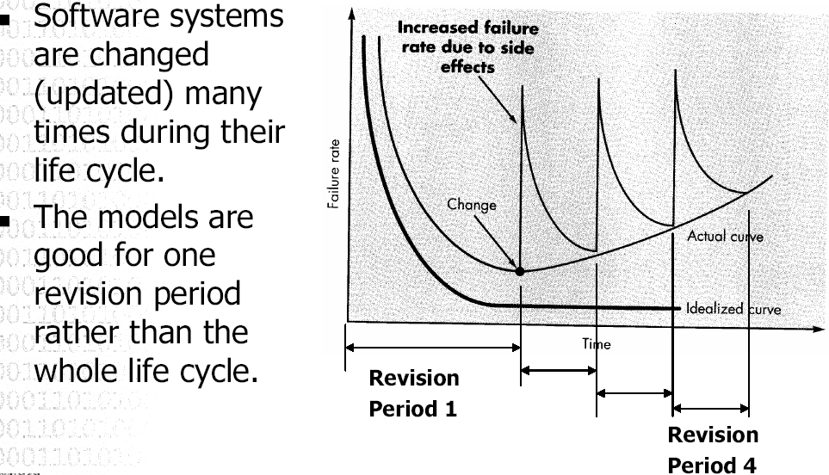
Software Reliability Modeling

Slide 16
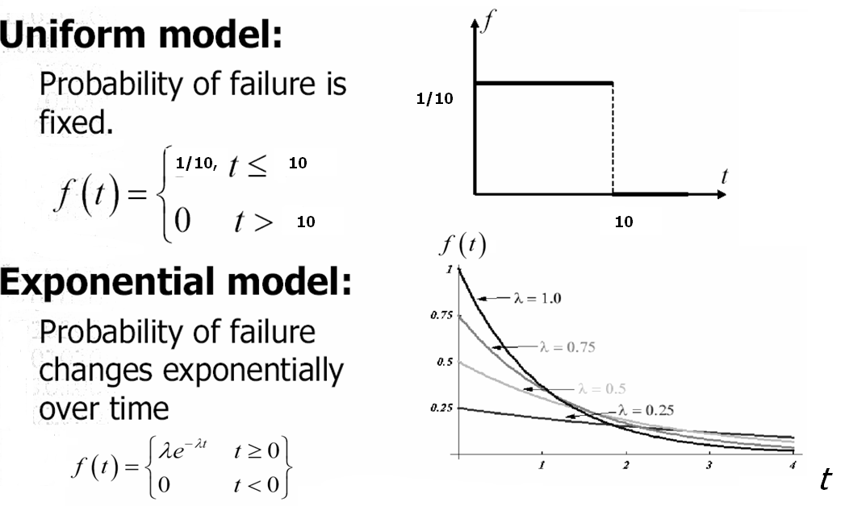
Basics of Reliability Theory

Slide 17

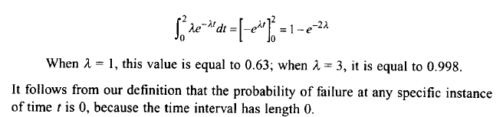
Basics of Reliability Theory
Given the pdf function f(t), the probability that the component fails in a given time interval [t1,t2] is:
Example:
for the uniform pdf on the previous slide the probability of failure from time 0 to 2 hours is 1/5
For the exponential pdf on the previous slide, the probability of failure from time 0 to 2 hours is :

Slide 18
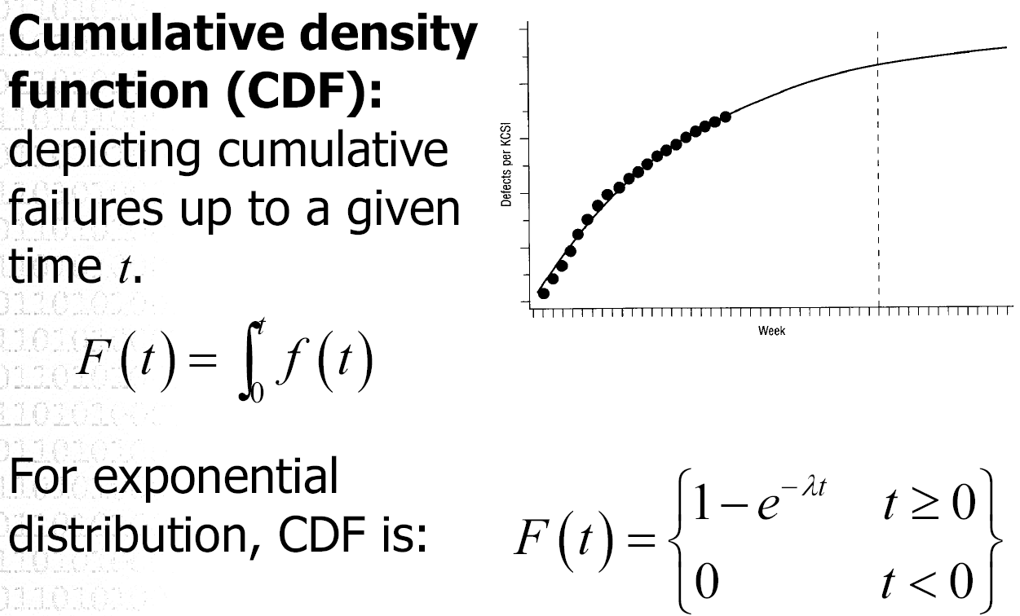
Basics of Reliability Theory
dt

Slide 19
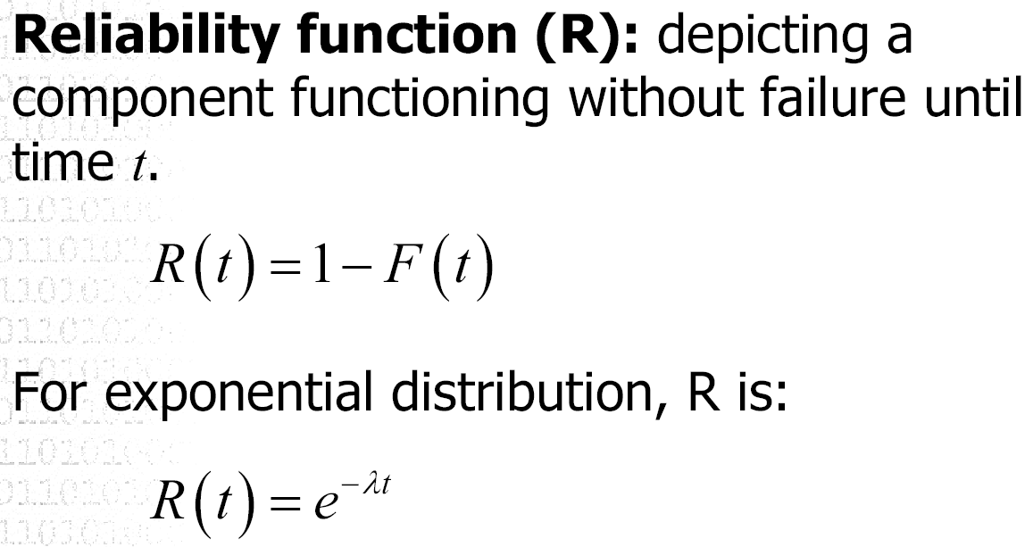
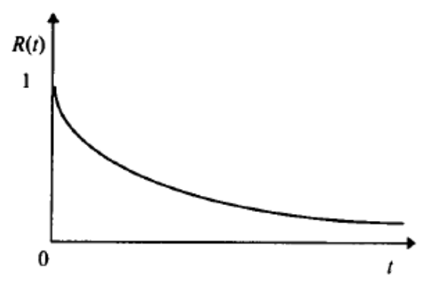
Basics of Reliability Theory

Slide 20
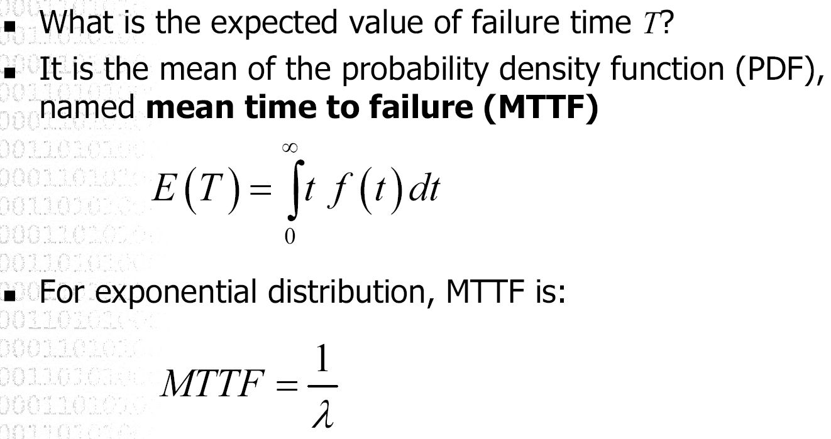
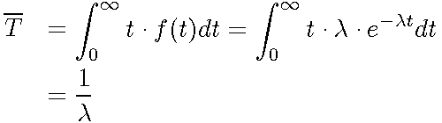
Basics of Reliability Theory
E(T)

Slide 21
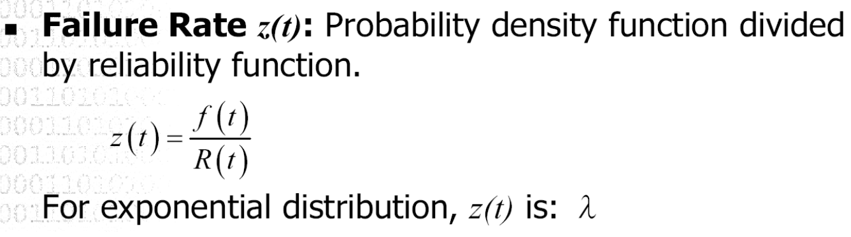
Basics of Reliability Theory

Slide 22

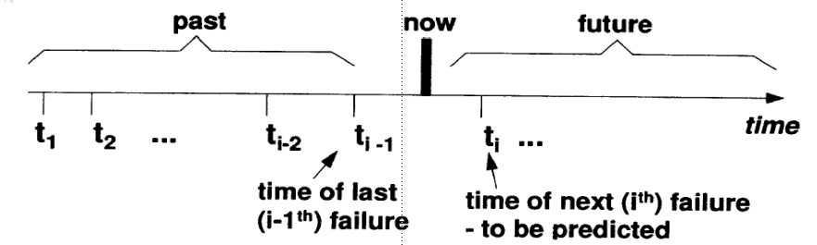
Software Reliability Growth Problem
In software we want to “fix” the problem, i.e., to have a lower probability of failure after a repair
or having longer
The quality of the product improves over time, and we talk about reliability growth
We need a model for reliability change over time

Slide 23
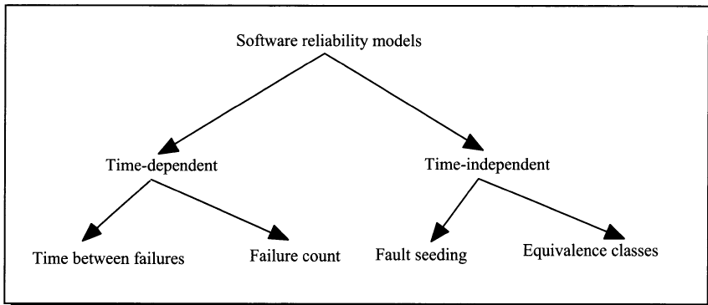
Taxonomy of Software Reliability Models

Slide 24
Time Between Failure Reliability Models
Reliability is a function of time
  Time between successive failures
  Failure counts completed over time
Time variable is regarded as a random variable characterized by a certain probability density function, (pdf).
The reliability models in this class vary with respect to the assumptions made with regard to the form of the pdf.

Slide 25
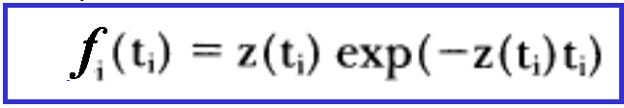
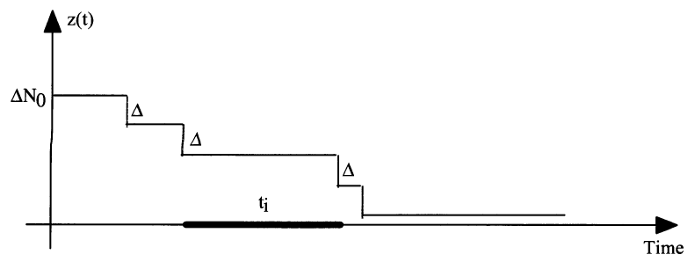

Time Between Failure Reliability Models:
Jelinsky & Moranda, 1972
Failures occur at some discrete time moments t₁, t₂, …
  t_{i} are independent exponential distributed random variables
N₀ – number of initial faults is unknown
Hazard rate (the probability of failure in interval t_{i} ):

Slide 26



Time Between Failure Reliability Models:
Jelinsky & Moranda, 1972
After n failures the mean Time To Failure (MTTF) is computed as follows:
Inference procedure: maximum likelihood estimation
Objective:
0

Slide 27
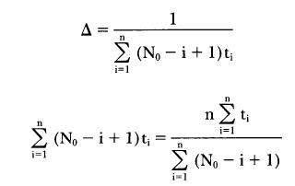
Time Between Failure Reliability Models:
Jelinsky & Moranda, 1972
Objective:
Resolve numerically the following two equations with respect to the parameters of the model using any method of non-linear optimization:

Slide 28
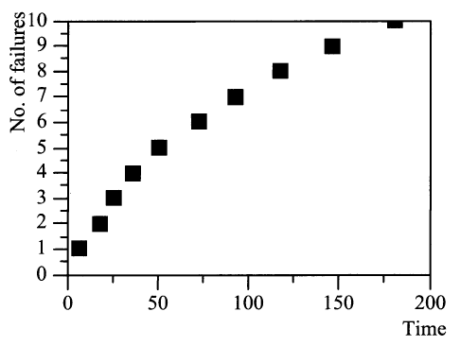

Jelinsky & Moranda Model: Example
Sample software reliability data:
t₁=7, t₂=11, t₃=8, t₄=10, t₅ =15, t₆ =22, t₇ =20, t₈ =25,
t₉ =28, t₁₀=35
Model parameters values:
Estimated MTTF:

Slide 29
Jelinski-Moranda Model
Assumptions:
  The software has N₀ faults at the beginning of the test.
  Each of the faults is independent and all faults will cause a failure during testing.
  The repair process is instantaneous and perfect, i.e., the time to remove the fault is negligible, new faults will not be introduced during fault removal.

Slide 30

Goel-Okumoto Imperfect Debugging Reliability Model
This model extends the basic JM model by adding an assumption:
  A fault is removed with probability p whenever a failure occurs.
  The failure rate function of the base JM model with imperfect debugging at the i^{th} failure interval becomes
  λ (t_{i}) = ф [N- p( i – 1)], i =1, 2,…,N
  The reliability function is
  R(t_{i}) = e ^{-ф (N-p(i-1))t}_{i}

Slide 31
Failure Counting Reliability Models
Concerned with counting the number of faults detected in a certain time interval
A representative model: Goel-Okumoto NHPP reliability model

Slide 32
Non-homogeneous Poisson process (NHPP)
Non-homogeneous Poisson process (NHPP):
This group of models provides an analytical framework for describing the software failure phenomenon during testing.
The main issue in the NHPP model is to estimate the mean value function of the cumulative number of failures experienced up to a certain time point.

Slide 33

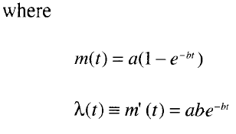
Goel-Okumoto NHPP Reliability Model
Model:
N(t): Cumulative Number of Failures at time t
N(t) is as a Poisson process with a time-dependent failure rate
File dependent rate follows an exponential distribution

Slide 34

Goel-Okumoto NHPP Reliability Model
In this equation:
m(t) is expected # of failures over time
(a.k.a. the cdf F(t))
is the failure density (a.k.a. probability density function f(t))
a is the expected number of failures to be observed eventually
b is the fault detection rate per fault
Model:

Slide 35
Types of reliability
Inter-rater: Different people, same test.
Test-retest: Same people, different times.
Parallel-forms: Different people, same time, different test.
Internal consistency: Different questions, same construct.

Slide 36
Next
Time independent Software reliability models
Computation of System reliability

